Slide 17
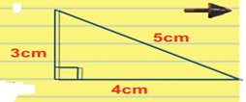
In right angle triangle the square of hypotenuse is equal to the sum of square of the other two sides.
5² =3² +4²
25= 9+16
Right angle triangle

Slide 18
(2m) ² + (m² – 1)² = (m² +1)

Slide 48
